Slide 1
Automatic Malware Detection, Analysis, and Mitigation in Splunk
Jose E Hernandez
Security Specialist, Splunk

Slide 2
Disclaimer
During the course of this presentation, we may make forward looking statements regarding future events or the expected performance of the company. We caution you that such statements reflect our current expectations and estimates based on factors currently known to us and that actual events or results could differ materially. For important factors that may cause actual results to differ from those contained in our forward-looking statements, please review our filings with the SEC. The forward-looking statements made in the this presentation are being made as of the time and date of its live presentation. If reviewed after its live presentation, this presentation may not contain current or accurate information. We do not assume any obligation to update any forward looking statements we may make. In addition, any information about our roadmap outlines our general product direction and is subject to change at any time without notice. It is for informational purposes only and shall not, be incorporated into any contract or other commitment. Splunk undertakes no obligation either to develop the features or functionality described or to include any such feature or functionality in a future release.

Slide 3
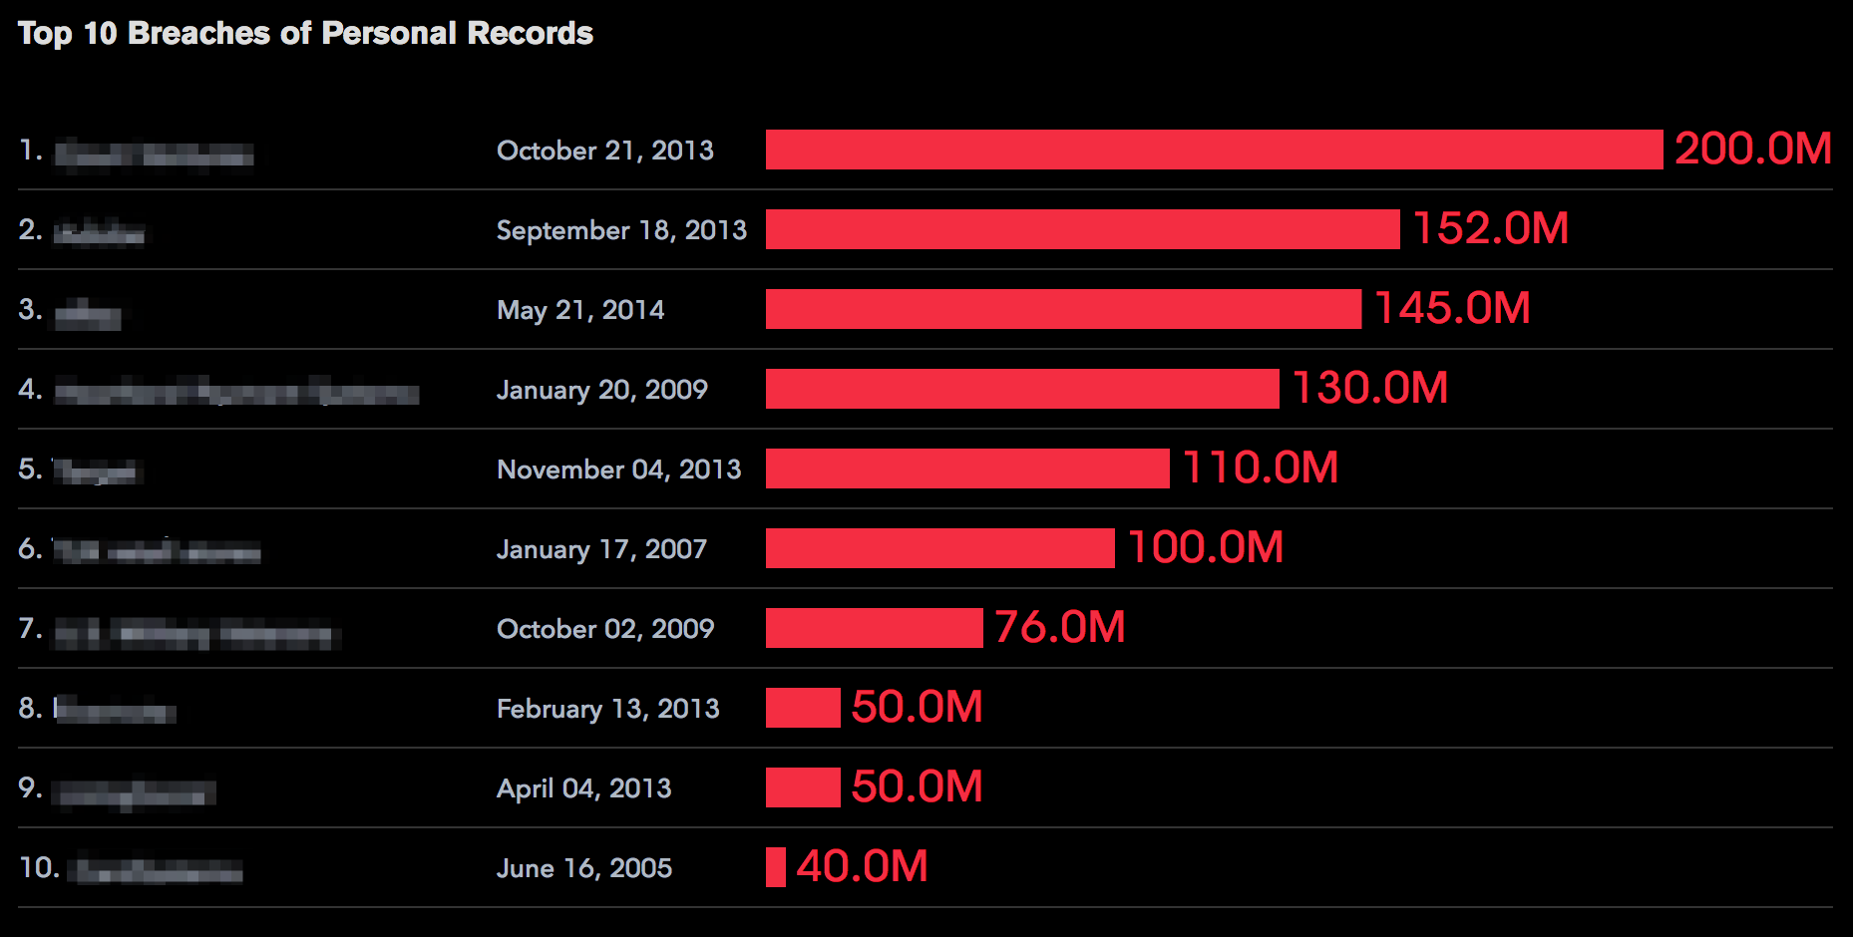
http://www.bloomberg.com/infographics/2014-08-21/top-data-breaches.html

Slide 4
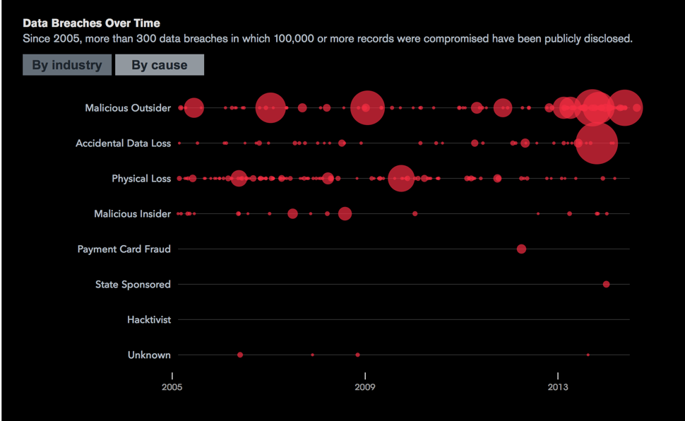
http://www.bloomberg.com/infographics/2014-08-21/top-data-breaches.html

Slide 5
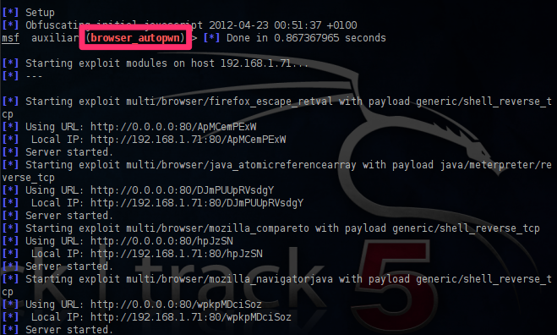
Red Team has Auto PWN Where is our Auto Mitigate?
http://pentestlab.wordpress.com/2012/04/23/metasploit-browser-autopwn/

Slide 6
Intro
Intro self (This slide does not need to exist in final version)

Slide 7
Agenda
Intros
What we set out to accomplish
The Build out
The Known
The Unknown
Prevention
SAM (SA-Mitigation) in-Depth
Closing

Slide 8

Auto Mitigating Attacks with Enterprise Security
Notes:
Talk about the goals of the talk
Goal: Prove that we can close the loop with Splunk
Introduce Mitigation with Splunk
Challenges:
Endpoint Threat Detection Using Splunk
Mitigation Capabilities
Lack of Windows Knowledge..

Slide 9

Auto-mitigation is not Heresy!
Is an accepted business risk
Notes:
disarm naysayers of auto Mitigation

Slide 10




Basic Attack Architecture
Palo Alto Layer 7 Firewall
Vulnerable Win 7
Metasploit VM
Traffic Flow
Traffic Flow
Logs
Logs

Slide 11
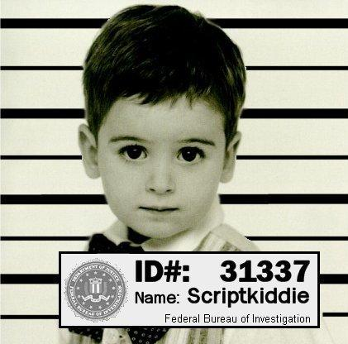
The Known
Notes:
First Example of Auto Mitigation Applied
NEED MORE POWERFUL IMAGE

Slide 12

Attack Scenario #1
Layer 7 FW
Attack
IDS Event to a Critical Server

Slide 13
Attack Scenario #1
Layer 7 FW
Corp Machine
Attack
IDS Log
Bypass FW
IDS Event to a Critical Server

Slide 14
Attack Scenario #1
Layer 7 FW
Corp Machine
Attack
IDS Log
Bypass FW
IDS Event to a Critical Server
IDS Event to a Critical Server

Slide 15
Attack Scenario #1
Layer 7 FW
Corp Machine
Attack
IDS Log
Bypass FW
Block
IDS Event to a Critical Server
IDS Event to a Critical Server

Slide 16
“Let me Show You”

Slide 17
The Known
Attack
Not Blocked
Visibility
Analyze
Audit
Attack was launched at a High Criticality Asset
Palo Alto was not set to block those specific IDS Alerts
Splunk got visibility of the attack via IDS log
Splunk analyzed the alert and with added context decided to block
Splunk decided to mitigate, sends a block message to the Palo Alto
Full history if this in the mitigation tracker
Mitigate
Notes:
What did you just saw?
We can easily block that
This is pretty basic scenario

Slide 18

















Mitigation Framework
SA-Mitigation
Web Services
Desktops
Packaged Applications
Networks
Real-time Machine Data
Security
SA-LWF_Mitigater
Custom
Applications
RFID
Servers
Online Services
Databases
Notes:
Good time to talk about the mitigation framework

Slide 19
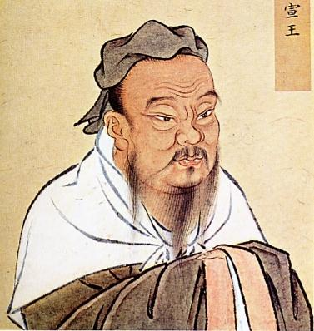
Close The Loop
Visibility
Prevention
Analysis
Mitigation
Before The Loop Closes You!
Notes:
Is all about closing the loop

Slide 20
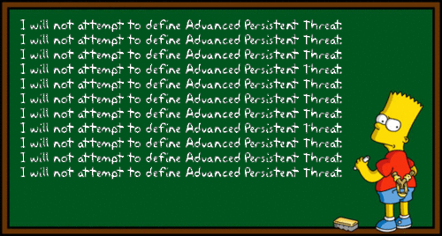
The Unknown (APTs, 0days, etc...)

Slide 21
Attack Scenario #2
Running Vulnerable Service
Layer 7 FW
exploit
exploit
Metasploit

Slide 22
Attack Scenario #2
Running Vulnerable Service
Layer 7 FW
exploit
exploit
Metasploit
Setup Persistence
Splunk LWF

Slide 23
Attack Scenario #2
Running Vulnerable Service
Layer 7 FW
exploit
exploit
Endpoint logs
Metasploit
Setup Persistence
Splunk LWF

Slide 24
Attack Scenario #2
Running Vulnerable Service
Layer 7 FW
exploit
exploit
Endpoint logs
Metasploit
Setup Persistence
Splunk LWF
Registry Key with Random Chars

Slide 25
Attack Scenario #2
Running Vulnerable Service
Layer 7 FW
exploit
exploit
Endpoint logs
Metasploit
Setup Persistence
Splunk LWF
Registry Key with Random Chars
Remidiate

Slide 26
“Let me Show You”

Slide 27
The Unknown
Determine is an attack due to registry key placed in incorrect place with random characters
Mitigated
Attacker infects vulnerable machine on the network
Bypass
Analysis
Send mitigate_proc command to endpoint to kill process and do clean up
Mitigated
Not only is the attack mitigated the endpoint has been cleaned from the foothold

Slide 28
Prevention

Slide 29
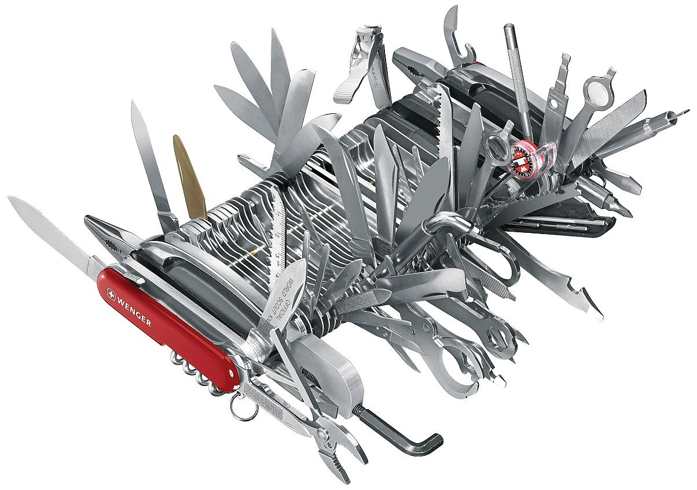
Just a Framework
Think of the Use Cases
Notes:
Threat Intel Augmentation

Slide 30
Find more at http://git.. Authors:
Brian - bluger@splunk.com
Monzy - mmerza@splunk.com Jose – jose@splunk.com
Notes:
Call to Action
Make Business use case for auto mitigation

Slide 31
Sample with screenshot
Screenshot here

Slide 32
Sample Two-column Format
Subhead
Sample two-column format
Sample two-column format
Sample two-column format, sentence
Second bullet

Slide 33
Splunk Object Style

Slide 34
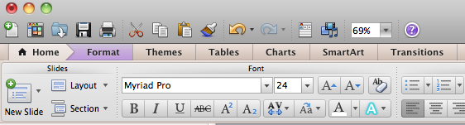
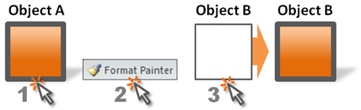
Applying Splunk Object Style
To apply the Splunk object style to any shape:
Select the shape with the desired style
Click on Format Painter (paintbrush) tool in toolbar
Apply style to any new shape

Slide 35




Logos
Splunk Corporate Logo
Hunk Logo
Splunk Product Logo
Splunk Powered Logo

Slide 36













Splunk Icons
search
bar chart
lock
cloud
open cloud
check mark
envelope
android
iPad
iPhone
storage
storage - 3
firewall
datacenter
server
indexer
forwarder
search head
Splunk server
desktop
laptop

Slide 37


















Splunk Icons Cont’d
application
virtual machine
virtual server
network
www or global
tools
document
log file
RFID
router
load balancer
script
shopping cart
alert
user
users
gears/settings
gear
messaging
tag/ticket
gps tower

Slide 38













Splunk Icons
Android
iPad
iPhone
Checkmark
Alert
Info
Stop
Twitter
Facebook
LinkedIn
RSS
You Tube
GPS Tower
Shopping cart
Healthcare
Hospital
Office building
VoIP Phone
Support
POS Card Reader
RFID

Slide 39













Splunk Icons

Slide 40
Arrows

Slide 41
Table Example
Column Title | Column Title | Column Title | Column Title
Text | Text | Text | Text
Text | Text | Text | Text
Text | Text | Text | Text
Text | Text | Text | Text
Text | Text | Text | Text

Slide 42
Table Example
Column Title | Column Title | Column Title | Column Title
Text | Text | Text | Text
Text | Text | Text | Text
Text | Text | Text | Text
Text | Text | Text | Text
Text | Text | Text | Text

Slide 43

Sample Customer Success
“Splunk makes it cheaper and easier for Hughes to analyze network traffic for enterprise customers as well as manage bandwidth for consumer and small business customers.”
Screenshot or graphic here
Customer name Customer company
Customer logo here
Bullet placeholder
Bullet placeholder
Bullet placeholder

Slide 44
Timeline Chart
Milestone
Event
Q1
Q2
Q3
Q4

Slide 45
Chart Example
N% growth over FYxx
Number
Number
Number
Number
Actual
Number
Planned
Previous Year
FY08
FY09
FY10

Slide 46
Quote Box
“A pessimist sees the difficulty in every opportunity; an optimist sees the opportunity in every difficulty.”
- Winston Churchill

Slide 47
Quote Box

Slide 48
Quote Box

